Slide 1
Theatre History
How Theatre Began: Theatre History Overview

Slide 2
Origins

Slide 3
I. Origins
A. Early humankind attributed forces that controlled their well being as Supernatural. As a means to appease the unknown, primitive theatre came about. There were 4 forms:
1. Shaminism— Priestly figure who communicated directly with the gods used many theatrical elements of dialogue, song and dance.
2. Dance—Enactment of ritual and the rhythms of life through movement, masks and costumes added many elements of the theatrical.
3. Ritual—A repetitive, sacred imitation of myth as a means to appease the gods was an early instrument to communicate to the divine.
4. Storytelling—The retelling and reenactment of oral tradition.

Slide 4
I. Origins
B. First Actors were cave dwellers who re-enacted hunting adventures.
C. First recorded play was in Ancient Egypt around 2000 B.C.
1. The first play was the Abydos Passion Play. Passion Plays depict the sufferings and triumphs of the gods. Passion Plays are still performed to this day.

Slide 5
II. Greek drama
534 BCE- 336 BC

Slide 6
II. Greek drama
First structured drama took place in approximately 500 B.C.
Choral odes or hymns sung by dancers were called dithyrambs which was where Greek tragedy originated from.
The word tragedy comes from a goat song sung by satyrs, who were goat-like creatures. The song was called tragodia or tragos. During a dithyramb, or a ritualistic performance, a goat was sacrificed.
Thespis was the first playwright who stepped out of the chorus and spoke to the audience while he dramatized the story. This is known as the birth of acting.
Week of drama festivals were given each spring in honor of Dionysus, the god of wine and fertility.

Slide 7
II. Greek drama
F. Winning playwrights emerged who were awarded the highest honor of the city state, a laurel wreath. 4 playwrights who still perform today are:
1. Aeschylus—
Wrote about man’s conflict with the gods.
Wrote famous trilogy, The Orestia.
Introduced 2nd actor
2.Euripides—
Wrote about man’s conflict with man.
Wrote Trojan Women, and Medea
Introduced 3rd actor.
3. Sophocles—
Wrote about man’s conflict with himself.
Wrote Antigone and Oedipus Rex, which is the most famous of all Greek tragedies

Slide 8
II. Greek Drama
4. Aristophanes—
Wrote comedy
Wrote Clouds, Lysistrata, and Frogs.
G. Theatre architecture—
Orchestra—Circular dancing area about 60-70 feet in diameter. Used by chorus.
Proskenium—A slightly elevated platform that was backed by a structure with large doors used as scenery. Stage
Parodos—An entrance used by the audience to reach the auditorium and the chorus to proceed to the orchestra.
Skene—A dressing area for the actors, originally outdoors behind the Proskenium. Where term green room comes from.
Thymele—the altar where sacrifices were made to Dionysus at the beginning of each performance. In the center of the Orchestra.
Theatron—Seats were bowl shaped and built at a steep slant upward. Theatron seated approximately 15,000 people!

Slide 9
II. Greek Drama
A. Greek Theatre
E. Skene
G. Theatron
B. Proskenium
D. Orchestra
F. Parados
C. Thymele

Slide 10
II. Greek Drama
H. Fall of Greece–336 B.C., Romans took over Greece and it’s theatre, basically expanding it and making it bigger.
Romans liked spectacle and gore. Their theatre reflected this.
Two playwrights emerged: Seneca and Plautus.
Seneca: Adapted Greek plays, like Medea
Plautus: Comedic playwright who used stock characters, characters who the audience recognized and were used in many plays.
Roman comedy was very vulgar and domestic.
I. Rome fell in 476 A.D. and the church banned theatre because it became vulgar and profane.

Slide 11
III. Medieval Drama
900-1500

Slide 12
III. Medieval Drama
While the Western world was in a dark age as far as art and humanity was concerned, the Eastern world was blossoming.
India—Sanskrit performed in palace gardens for educated ruling class.
China—Two types:
Ritualistic–Quiet, classic approach, ancestor worship, interpretive dance, elaborative costumes
Theatre of Action—Acrobatic stunts, songs, and vigorous dances

Slide 13
III. Medieval Drama
Purple is additional material that you don’t need, unless you want it.
Japan—Ritualistic dance of Shintoh religion.
Noh—For aristocracy. Classical language, Elaborative masks
Kabuki—For common man, acrobats. Some ways resembles American musical. Came into existence in 1600 when a female dancer created performances combining traditional Buddhist dances with more contemporary forms. Later women were barred from the stage. The makeup on the actors tell the audience what type of character the actor is playing, i.e. Gods, warriors, heroine, evil spirits, etc.

Slide 14
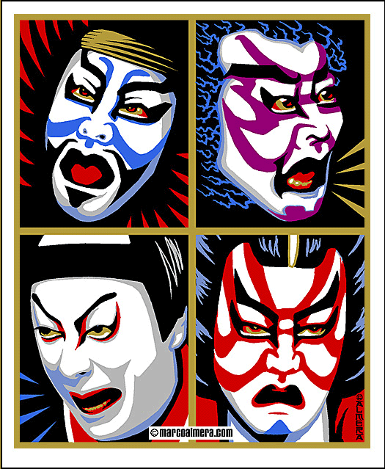
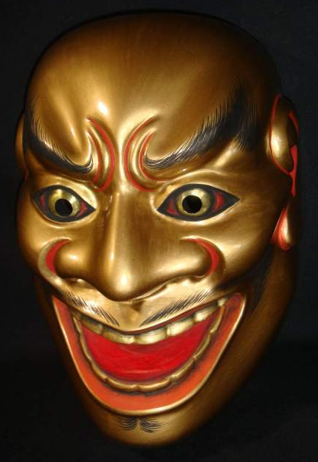
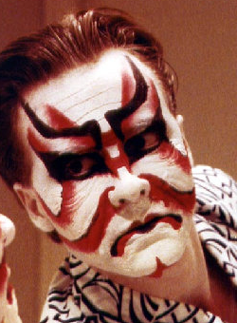
III. Medieval Drama
Kabuki Make up
Noh Masks

Slide 15
iii. Medieval drama
B. Medieval Europe—Theatre was outlawed, but it eventually re-emerged in the church.
Trope—Short dramatized scene based on scripture. This was the origin of the three different forms of medieval drama.
Three types:
Mystery—About the Biblical life of Christ
Miracle—Dealt with the lives of the saints
Morality— Personified virtues and vices, depicting moral struggle of the soul.
Mansions–Small structures within the church originally used for worship and transformed for performance spaces. Encompassed heaven, hell, and earth. Hell became by far the most popular scene and the devil became a humorous and likeable character.
Eventually plays were banned from church to marketplace because they got too bawdy and vulgar.
Wagons—Traveling stages that went from marketplace to marketplace.

Slide 16
IV. Theatre of the Renaissance and Elizabethan era
1500-1660

Slide 17
IV. Renaissance and Elizabethan
Rebirth of Classical Greek and Roman ideas, literature, and art. Transformation of philosophy from religion to humanity. Humanism was a basic belief that humans were basically good, and life is meant to be enjoyed.
Began in Italy
Commedia del Arte—
Improvisation around set scenario–comic characters such as elderly husbands and young wives, gullible masters and tricky servants, young lovers and overprotective, controlling fathers.

Slide 18
IV. Renaissance and Elizabethan
Stock Characters
Character Name | Characteristics | Relationship to others
a. Harlequin | Wise, wore patches | Usually the servant
b. Pierrot | Lovelorn and Moody | Young Lover of Columbine
c. Pantalone | Comic in baggy pants | Pompous middle-aged father
d. Columbine | Flirtatious and pretty | Daughter of Pantalone. In love with Pierrot, but required to marry someone much older. She has a mind of her own.

Slide 19
IV. Renaissance and Elizabethan
Slapstick Comedy–Energetic, sometimes acrobatic, physical comedy. Think Marx brothers or 3 Stooges.
Italian Theatre Architecture.
First proscenium built in 1618.
Ornate prospective scenery and raked Stages. See picture 2.
Chariot and pole system–slots were cut through the stage floor and poles passed through. Flats were mounted on the pole and were attached beneath the stage to chariots that ran on tracks parallel to the front of the stage. When chariots ran toward the center of the stage, flats were carried into view.

Slide 20
IV. Renaissance and Elizabethan
Spain–Spanish Golden age
Playwrights
Lope de Vega–most prolific of all Spanish playwright, His life was as interesting as his plays. He was a member of the Spanish Armada, secretary to a noble man, had many business and love affairs, and later became a priest.
Calderon–Wrote Life is a Dream, a philosophical allegory about the human situation and the mystery of life. Very famous Spanish play
Plays about—Adventure, Chivalry, and Romance

Slide 21
IV. Renaissance and Elizabethan
France
Theatre for aristocracy
Jean Baptiste Poquelin or Moliere wrote Tartuffe.
His plays poked fun of the aristocracy, .
Neoclassic ideals—French academy—group of men who decided what ideal art and theatre should be—were extremely strict about Aristotle’s elements of tragedy, especially unity of time and place of action.
Verisimilitude–Likeness to life.

Slide 22
IV. Renaissance and Elizabethan
England
Under Elizabeth I, the arts flourished. James I succeeded her and kept the tradition alive.
Sponsored traveling groups of players, Shakespeare’s Lord Chamberlain’s men among these. Lord Chamberlain’s men became the King’s Men because they were sponsored by King James I.
Well-known playwrights:
Christopher Marlowe—Wrote Dr. Faustus, creator of blank verse (unrhymed, iambic pentameter.)
Ben Johnson—Next to Shakespeare, finest Elizabethan playwright. Wrote Volpone.
William Shakespeare–“He wasn’t of an age, he was for all time.” Universal themes, audiences represented all classes, from the poorest of the poor to the richest of the rich.

Slide 23
IV. Renaissance and Elizabethan
Globe Theatre—looked like inn yards—round or octagonal in shape because most theatre companies began as traveling companies and performed in inn yards. Later permanent theatres fashioned after these. Open, out-doors theatre, performances were in the afternoon.
Actors were men and boys.
Pit–yard where groundlings surrounded the thrust stage.
Galleries–covered seating areas with benches surrounding the stage. For the upper-classes.
Tiring house– Permanent structure behind the covered thrust stage. Housed the props and acted as a green room, as well as provided permanent background. Like the Greek Proskenium.
Trap door– Special appearances and disappearances were made underneath the stage. Known as hell.
Heavens– another trap door appeared on the roof of the stage. Angelic creatures were flown in from this space, like Arial from The Tempest.
Doors– Two main doors on each side of the main center entrance.
Study– Recessed curtained area in the center of the stage used for entrances and interior scenes.
Terrace– Three separate balconies above the stage, used for upper scenes, aka, Romeo and Juliet, and for the musicians loft.
Costumes were fine Elizabethan clothes. There was no attempt at authenticity

Slide 24
IV. Renaissance and Elizabethan
A. Elizabethan Theatre
B.
Heavens
F. Terrace
E. Study
C. Hell
D. Pit

Slide 25
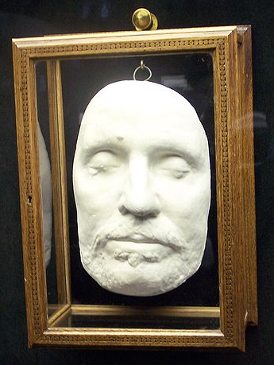
IV. Renaissance and Elizabethan
Death of Theatre—1642--1658
Charles I, successor of James I was beheaded and Puritan Oliver Cromwell took over and banned all plays, putting actors into jail.
Theatres were closed for 16 years under the Puritan rule, ending probably the most brilliant eras of theatre ever known. The Globe theatre was torn down and King’s Men sold its wardrobe.
Death Mask of
Oliver Cromwell

Slide 26
v. Restoration
1660-1800

Slide 27
V. restoration
After Oliver Cromwell’s reign, Charles II returned to England and restored theatre.
Theatre for the nobility.
Comedy of Manners style which poked fun of aristocracy and their lifestyle and manners.

Slide 28
v. Restoration
D. Three well-known playwrights emerged:
Oliver Goldsmith— She Stoops to Conquer
Richard Brimsley Sheridan— School for Scandal, and The Rivals. Famous character–Mrs. Maloprop.
William Congreve—Way of the World
Women performed legally on stage for the first time!
David Garrick–considered the greatest Shakespearean actor of all time. Known for his naturalistic style, as opposed to the presentational style that was common. He made Shakespeare continue to be popular in England and across the world.
Theatre Architecture. Proscenium arch stages with open platform forward of proscenium.

Slide 29
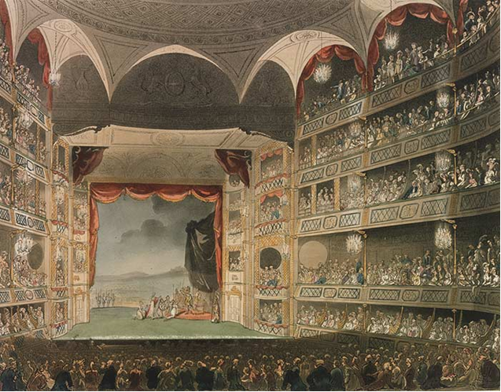
A. Restoration Theatre
B. Proscenium Arch
C. Boxes
D. Galleries
E. Pit

Slide 30
Vi. Theatre of the Romantic PEriod
1800-1929

Slide 31
VI. Romantic period
Revolt against neoclassic form.
Picturesque stories
Lovely setting
Happy ending
American Showboats—touring companies traversed the continent by river, docking and performing one night engagements. Usually performed melodramas.
Melodrama—Unnaturally exaggerated acting with stock characters–villain, hero and heroine.
Minstrel—Comedy song and dance acts, master of ceremonies, African American music and dance, black face–white actors would paint their faces black and imitate stereotypical behaviors. There were also all black minstrel shows.

Slide 32
vi. Romantic
Vaudeville—Variety shows, singing, dancing, comedy acts. Family friendly
First musical, The Black Crook, Year 1860. Melodrama interspersed with singing and dancing. Lightly clad women wearing ballet costumes. Ran for 5 hours! Very popular.
Burlesque–Height of its popularity was before WWI. Main feature was lightly clad women added to the traditional vaudeville performance. Appealed to male audiences. Strip tease added in the late 1920's.

Slide 33
vii. Birth of Modern Theatre: Realism and Naturalism
1875-1900

Slide 34
VII. Modern Theatre
Revolt against romanticism and neoclassicism.
Naturalism—Nature was considered the first principle of the universe and all art should be true nature. Goal: Sheer verisimilitude as artlessly as possible.
Began by Emila Zola in 1873, French playwright and philosopher who stated his desire to base all dramatic work on scientific methods of observation.
Theatre became almost like a science project.
Slice of life— segments of life portrayed on stage in exact duplication of a photograph.
Influenced by Charles Darwin’s The Origin’s of the Species— influence of heredity and environment on man’s life and behavior.
Audience became like peeping toms, looking in on life, not a performance of a play.
August Strindberg—Miss Julie, a representative naturalistic play dealing sexual conflict between men and women. It dealt heavily with heredity and environment. Unusual setting–a triangular view of the corner kitchen.

Slide 35
vii. Modern theatre
Realism— Goal: Likeness to life, but art and the play was still main focus.
Characters based on real life human beings.
All action is motivated.
Contemporary social problems.
Exposition material was interwoven in cause and effect sequences.
Realistic scenery, costumes, and characterization. Box set employed for the first time.
Henrick Ibsen—1828—1906 Norwegian. (most representative playwright of the school.) Wrote A Doll House, Hedda Gabler. Known as father of modern Drama

Slide 36
vii. Modern theatre
George Bernard Shaw—(1856—1950) Irish/ English. Wrote Pygmalion, play that “My Fair Lady” is based on.
Oscar Wilde—(1856—1900) Irish/English. Wrote comedy of manners. Primarily a novelist and writer of social commentary. Although he is wrote in the period of realistic drama, he wasn’t a realistic dramatist. Wrote The Importance of Being Earnest
Anton Chekhov—(1860-1904) Russian. Wrote The Cherry Orchard, Three Sisters, The Seagull. His realistic scripts required a realistic approach to acting.

Slide 37
vii. Modern theatre
Stanislavski(1863-1938)
1. Moscow Art Theatre-New school of realistic acting run by Stanislavsky and Vladimir Nemirovich-Danchenko
2. Performed Checkov’s plays
3. Created a system of acting technique.
4. Wrote many books on acting that many actors cite as their major source book today. A must read is An Actor Prepares.
Laboratory Theatre– In 1923-24, The Moscow Art Theatre toured the U.S. Two of Stanislavski’s actors, Richard Boleslavsky and Maria Ouspenskaysa stayed to open up the American Laboratory Theatre in New York. This was where Stanislavski’s acting system was introduced for the first time in the United States.

Slide 38
VII. Modern theatre
Group Theatre–Harold Clurman, Lee Strasberg, and Stella Adler. Left the ALT and created their own actor training school modelled after the Moscow Art School. The system became the method
Stella Adler didn’t agree with Lee Strasberg’s method, especially his heavy reliance on emotional memory, so she travelled to Paris to study with Stanislavski himself. She learned that Stanislavski had left the emotional memory technique behind long ago.

Slide 39
VIII. Theatre of Non-Realism
Late 1800’s—Early 1940’s

Slide 40
VIII. Theatre of Non-Realism
Symbolism—Goal: Purity of vision, not accuracy of reality.
Counter-movement to Naturalism and Realism
Generic, symbolic characters
Reality is communicated through symbols and metaphors
Key Playwright: Maurice Maeterlink—(1862—1949) Blue Bird, and Pelleas & Melisande
An attempt to penetrate reality; shatter the consciousness
Inspired by Edgar Allen Poe

Slide 41
VIII. Theatre of Non-Realism
Irish Renaissance—1900; The Irish made an artistic revolt against the English, asserting their Irish heritage in plays performed at the Abby Theatre in Dublin.
John Millington Synge—(1871-1909) Playboy of the Western World; Riders to the Sea
Lady Augusta Gregory—(1863—1935) Rising of the Moon

Slide 42
VIII. Theatre of Non-Realism
Expressionism—Opposed realism and naturalism with subtle symbols, bold scenery, crude superhuman power, strong human emotion and attitudes projected into inanimate objects.
Inspired by impressionistic paintings, Van Gogh.
Bertold Brecht (1891-1956)--Caucasion Chalk Circle, Mother Courage and Her Children. His approach to theatre was called Epic. He believed that audiences should be actively involved in his performances by creating strange effects, such as pictures projected onto screens, evoking an emotional response in his audience. He wanted audiences to relate what they saw in the theatre to what they saw in the real world. He thought Epic theatre had the power to change the world.

Slide 43
ix. Post-Modern Theatre
1940—Present

Slide 44
ix. Post-Modern Theatre
Theatre of the Absurd— Man is without purpose in a world without meaning.
Samuel Beckett (1906-1989) Irish Waiting for Godot, The Birthday Party
Eugene Ionesco (1912-1994)—The Bald Soprano, Chairs
American Legendary Playwrights—Theatre of ideas, psychology, characterization, utilizing styles of the past as well as creating new ideas and methods of drama.
Eugene O’Neill (1888-1953)One of the most influential playwrights of all time. Styles ranged from realistic to experimental. Some plays include Long Day’s Journey Into Night, The Harry Ape, Ah! Wilderness
Thornton Wilder (1957-1975)—Known for his frank theatricality and simplicity. He is one of America’s finest playwrights. Some plays include Our Town, By the Skin of Our Teeth, Matchmaker

Slide 45
ix. Post-Modern Theatre
Tennessee Williams(1911-1983)—Known for magical realism, vivid characters caught in violent situations as they seek to recover the past. Some plays include: Glass Menagerie, Streetcar Named Desire, Cat on a Hot Tin Roof.
Lillian Hellman (1915-1984)—Woman playwright who wrote in a male dominated world proving herself to be one of the greatest playwrights of all time. Some plays include Little Foxes, and A Children’s Hour
Arthur Miller (1916–2005)—America’s playwright. American themes, characters, and situations. His plays show it is possible to maintain integrity even within the confines of society. Some plays include Death of a Salesman, View from the Bridge, The Crucible
Lorraine Hansberry (1930-1965) She wrote A Raisin in the Sun, a famous drama about a hardworking black family in Chicago whose dreams are shattered.

Slide 46
ix. Post-Modern Theatre
Golden Age of Musical Theatre—song, dance and acting. (1950’s—1960’s)
Began as musical revue/vaudeville/burlesque
Showboat—Jerome Kern and Oscar Hammerstein II
i. First musical dealing with serious subject matter
Oklahoma—Richard Rogers and Oscar Hammerstein II
First musical where song furthered the plot.
Music, dialogue, plot and dance were fully integrated in this semi-serious plot.
Musical Theatre milestone

Slide 47
MUSICAL THEATRE
Well-Known Composers/Lyricists of the Golden Age
Richard Rodgers and Oscar Hammerstein II—Carousel, Sound of Music, South Pacific, and The King and I
Alan Jay Lerner and Frederick Loewe—My Fair Lady, Brigadoon, and Camelot
Frank Loesser—Guys and Dolls and The Most Happy Fella
Leonard Bernstein—West Side Story, On the Town, Wonderful Town, and Candide
Cole Porter–Anything Goes, Kiss Me Kate, Silk Stockings, and Can Can
Meredith Wilson—The Music Man and Unsinkable Molly Brown
Composers/Lyricists of more modern times
Stephen Sondheim–Into the Woods, Sweeney Todd, Sunday in the Park With George, Company, and Little Night Music
John Cander and Fred Ebb–Cabaret, Chicago, and Sweet Charity
Andrew Lloyd Webber–Phantom of the Opera, Evita, Cats, and Joseph and the Amazing Technicolor Dreamcoat

Slide 48
ix. Post-Modern Theatre
Current or very recent playwrights and plays that you should know:
Neil Simon—(1927--) Most successful playwright on Broadway after 1960. Known for his seriocomedies and coming-of-age plays. Some plays include: Barefoot in the Park, Brighton Beach Memoirs, Lost in Yonkers, The Odd Couple, and Rumors
Edward Albee—(1928--2016) Most prestigious American playwright. 1994 Pulitzer prize winner for Who’s Afraid of Virginia Woolf? Other famous play titles include Three Tall Women and American Dream
Tom Stoppard (1937--) Highly successful British playwright. Highly theatrical exploration of nature in reality–absurd themes. Some plays include Rosencrantz and Guildenstern are Dead, and Arcadia
Sam Shepard (1943--)Characters caught between dreams and reality. Family is a battle zone. Some plays include True West and Fool for Love
Lanford Wilson (1937--2011) His plays deal with humane treatment of misfits and rejects. Character relationships most important, storyline is minimal. Some plays include Fifth of July and Burn This

Slide 49
ix. Post-Modern Theatre
August Wilson (1945--2005) Themes concentrate on African-American identity and quests for fulfillment and dignity. Some plays include Fences and The Piano Lesson–Pulitzer
Luis Valdez (1940--) Best known Hispanic American Playwright. Writes plays about Aztec myth and Mexican-American life. Best known play is Zoot Suit
David Mamet (1947--) Most of his characters are obsessed with money and power. His style is heavy with expletives, i.e. swear words. Some plays include Glengarry, Glen Ross, and Oleana
Terrence McNally (1939--) Plays deal with gaps between people and the importance of trying to bridge them. Some plays include Lips Together, Teeth Apart, Master Class, Book for Ragtime, and Kiss of the Spiderwoman

Slide 50
ix. Post-Modern Theatre
A.R. Gurney— Themes range from coming of age to relationship of man and dog. Some plays include What I Did Last Summer and Sylvia
Alfred Uhry—Plays deal with the existence of prejudice in the modern world. Some plays include Driving Miss Daisy and Last Night in Ballyhoo
Marsha Norman (1947--) Plays deal with women who want a way out of the confines society places on them. Some plays include Getting Out, ‘Night Mother (Pulitzer) and Secret Garden (book and lyrics)
Wendy Wasserstein (1950–2004) Plays deal with the protagonists’ awakening of the feminist consciousness. Some plays include Uncommon Women and Others, Heidi Chronicles (Pulitzer), and Isn’t It Romantic?

Slide 51
ix. Post-Modern Theatre
Modern theater:
Live theater in the 21st century has to now compete with movies, which are seen as more accessible to the general public.
Theater Funding is lower than many other nations. The government allotment of money given to theater is far less than other industrialized nations.
Newest trends in Musical Theater:
The newest trend in Musical Theater has been a move from Musical to Movie and Movie to Musical. Examples of Musical to Movie include: Rent, Chicago, and Mama Mia. Examples of Movie to Musical include: Lion King (or all Disney musicals, really), Spider-Man, The Producers,Young Frankenstein, Billy Elliot, andSpamelot

