Slide 1
Let’s review our stage directions!

Slide 3
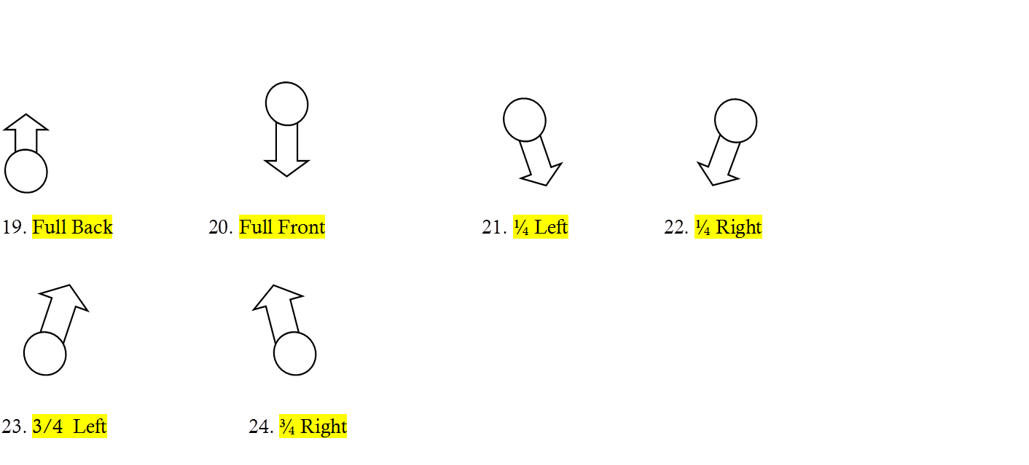
Remember these blocking positions?
25. Profile Left
26. Profile Right

Slide 4
A few tips…
25. Emphasis is telling the audience what to look at; or directing their eye at who should have the focus of the scene. In the films, the camera has this power; in the theatre it is the director’s job to direct the audience at
what to look at. The person who should have the focus, is usually the character who has more power in the given moment of the scene. You can do this in several different ways

Slide 5
Movement:
Any movement forces the audiences’ eye to look at the character moving. This is why characters usually move when they are speaking unless the director is trying to make a point and have an unspeaking actor move.
The rule behind this movement is to avoid distraction caused by someone moving when someone else is speaking.
Sometimes distraction is exactly what the director’s intention might be.
Moving only when speaking does not mean that the actor should only move while actually saying the line. Moving before or after a line can bring about very effective, yet very different results from movement that is strictly “on” on the line.
Movement before the line usually emphasizes the line, as long as the actor stands still to deliver the line. This technique can really bring attention to that actor and add intensity to that line. The movement becomes a dramatic set-up to the line.

Slide 6
More about movement…
Movement after the line will bring attention to the movement.
This can also provide a “cap” or period for the line. For example, if a character says, “I will no longer discuss this with you,” then moves and sits down, this movement declares the intention of the words with the final action.

Slide 7
Levels—refer to the actual head level of the actor. By adding platforms, chairs, and couches, and having actors stand, sit, kneel or lie down, creates emphasis. Usually the highest level is the most emphatic, but a level change is always emphatic. See overhead
Planes—Using all vertical areas of the stage; i.e., upstage, mid stage and downstage, in order to show emphasis. Usually the actor furthest downstage has the emphasis, with the exception of body and eye focus.
Eye Focus—Who is looking at whom is always emphatic. Usually when one is speaking, the other silent character is giving one’s eye focus to the speaker.
Body Focus—Shifting one’s body to angle towards an object or another character

Slide 8
Now, let’s look at and discuss the following four pictures.
PICTURE ONE

Slide 9
Who has the focus in this picture A? WHY?
The man because the woman is giving her eye and body focus to him.
B?
The man, because the woman is looking at him.
C?
The woman because she is further downstage.
D?
The women because he is giving both his eye and body focus to her.

Slide 10
Now, let’s talk about Stage Strengths and Emotional Value of the stage.

Slide 11
Number one through six in order of importance of the stage; one is the highest and six is the lowest.
5
2
6
3
1
4

Slide 12
Some authorities believe that each stage area has an emotional value as well. Therefore, directors might want to think about placing their actors in the following areas of the stage when they want to communicate a certain mood, feeling or emotion…

Slide 13
DOWN CENTER:
Climactic scenes, scenes where emotions EXPLODE!
UP CENTER:
Scenes of dignity, royalty, or formality.
DOWN RIGHT:
Love scenes and other intimate, warm units.
DOWN LEFT:
Routine business, soliloquies, or scenes that build tension.
UP RIGHT:
Eavesdropping or foreshadowing events.
UP LEFT:
Horror scenes, ghosts, and unreality.

Slide 14
Now, let’s talk about Composition, climactic compositions, and movement patterns.
Composition is static, caught movement that communicates characters’ desires, intentions, and motivations.
In a sense, a performed scene or play is a continuous alternation of composition and movement, and the composition is like the still photos communicating the characters’ inner desires. My college teacher, Tom McNally said to us once, that if a scene was directed well, and the actors were simply to go from composition to composition, without speaking, that the audience would understand what the scene was about.
Compositions have the following meanings:
See Picture 2

Slide 15
A and B like each other and confronting each other in anger or love. *Climactic Composition
A is playing hard to get with B the weaker.
B is playing hard to get, with A the weaker.
4. The relationship between A and B is disrupted completely
5. Although A and B face each other, they are separated in coolness.
*Obviously changing levels, planes, and eye focus could change the effects of these compositions, usually by giving one character more power over another.
Climactic Compositions are when two actors are standing very close together on the same plane. Climactic compositions should only be used for the highest moments of tension in the scene or play:
Extreme love—when two characters are about to embrace.
Extreme hate—when two characters are about to fight.

Slide 16
Now, you have to figure out how to get to the composite moments in your scene. This needs to be done through movement, or blocking.
The important thing about good movement is that it should tell a story by using creative and effective patterns.
Effective blocking also is purposeful. One of Dill’s favorite expressions is “ Move with purpose, or not at all!”
Let’s look at a few purposeful movement patterns by using volunteers to show them:

Slide 17
One character is moving towards a stationary character. What does this communicate? The moving character wants emotional or physical contact from the non-moving character.
One character is moving away from a stationary character. What does this communicate? A desire to avoid emotional or physical contact.
One character is moving toward a character who is moving away is called a chase scene, or cat-and-mouse. What does this communicate? One character wants confrontation, while another character wants to avoid it.
Both characters are moving away from one another. What does this communicate? Both characters no longer want physical or emotional contact.

Slide 18
Something else you want to think about when blocking a scene, is to create interesting movement patterns that create both tension and power-struggle.
The best way to do this is by using diagonal or curved crosses and levels.
Avoid using too much side-to-side crosses in your scene because they are not dynamic, the audience only sees profiles, and it doesn’t allow for any emphasis.
And remember, characters should move when they are speaking, and then STOP MOVING WHEN THEY ARE FINISHED. Also, actors need to avoid small side-to-side foot movement. Dill calls this TAP DANCING!

Slide 19
Side-to-Side=
Boring! Not dynamic. You can only see profiles.

Slide 20
Diagonal cross=
Dynamic because power and emphasis are established.
Who has the power?
The moving upstage actor has it because movement is always emphatic!

Slide 21
Curved Cross=
Interesting. Power and emphasis are established for the moving actor. This is good for long speeches.

Slide 22
Now, let’s do our first exercise. Each director will receive an open scene to direct. They will be given circumstances, and must direct their scene with all of the above tips. The audience will then guess the circumstances given. If time allows, directors might also have an opportunity to direct an open scene and provide their own given circumstances. Both scenes will be performed two times, one without text, and one with.

Slide 23
Let’s explore triangles, and different focus techniques!

Slide 24
The Powers of Triangles
No straight lines on stage. They are unnatural looking and they don’t direct focus to any specific character. Picture 3
No semi-circles on stage! They also don’t allow for emphasis. The audience has no idea who the emphatic actor is. Picture 4
Triangles are effective because they eyes of the audience travel along either side and focus on the figure at the apex. Generally the apex is upstage with the downstage characters turned at ¾ positions, throwing their eye and body focus upstage. Picture 5

Slide 25
However, you may place the apex almost anywhere on stage and vary the size and angle of the triangles. Again, the director will add emphasis for the audience by determining where the other actors are focusing with their eyes and bodies. This is called Direct Focus.
Picture 6
Direct/Indirect/and Counter Focus

Slide 26
Direct Focus When two actors look at or face the third actor.
A
B.
C.
Discuss:
a. When would be a good time to use direct focus?
b. Who is the dominant/emphatic actor? Why?

Slide 27
Indirect Focus When the eye of one actor looks at or faces another actor who is the one looking or facing the focus point. There is a roundabout approach that ultimately leads to the dominant actor.
A
B
C
Discuss
When would be a good time to use indirect focus?
Who is the dominant/emphatic actor? Why?

Slide 28
Counter Focus A focus that is opposed to the main focus. The eye is directed completely away from the primary focus, and this sets up a competitive tension between the two. This helps to break up the monotony of creating too many overly emphatic compositions. As with all compositional choices, a character in a counter focus must be motivated
C
A
B
Discuss:
What would be some motivations for a character in a counter-focus?
Who is the dominant emphatic actor?

Slide 29
Orchestration/ Rhythm and Tempo
A director shapes a production with space and time
When they manipulate space, they do this as a visual artist, or a master sculptor, with a highly acute eye for composition, use of levels and planes, emphasis, and movement patterns.
When they manipulate time, they become like an orchestra director, who shapes the music of the scene by influencing the speed, pauses, and volume levels of the script.
Rhythm : is a regular or irregular pattern of beats.
The pulsing quality in rhythmic experience is related to two fundamental life processes in nature:
The beating of the heart
The breathing pattern of the lungs
Rhythm also relates to the idea of tension and relaxation that exists daily in our human expressions.
Rhythm is incredibly seductive. It can lure an audience faster than any other technique available to a director.

Slide 30
EXERCISE: Explore space with different rhythms to express different human circumstances.
Tempo: Whereas rhythm is a regularly occurring accent, tempo is the rate of speed a scene should go. We also talk about this as pace.
It is important to explore different tempos in your scene.
Most scenes should run the gamut of a variety of tempos. Tempos to be tried are the following:
Super-slow, Slow, Medium, Medium-Fast, Fast, Very Fast
Volume: How loud or soft a scene is played.
Usually we talk about volume in the terms of musical expression. Pianissimo (very soft), Piano (soft), Moderato ( Medium), Forte (Loud), Fortissimo (very loud).
Each scene should have a clear climax and many peaks and valleys in orchestration.

Slide 31
Now, each director will get another scene with 3 performers. Directors will need to create the Given Circumstances of the scene through C.R.O.W:
Character
Relationship
Objective
Where
for their actors. Directors will be evaluated on use of emphasis, focus, triangles, composition, levels, planes, and orchestration in their scenes. Directors need to use at least 3 compositions in their scenes, with 1 climactic composition. Actors will be evaluated on commitment, stage presence, audience awareness, vocal techniques, and overall effect. Actors do not need to be memorized.

